Slide 1
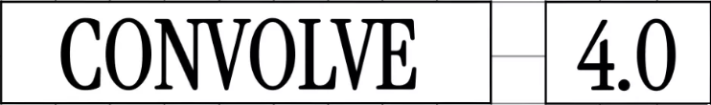

AI agents for the last mile
Convolve 2026 – MAS track
Yojana-Drishti
Vijay A - IIIT Hyderabad

Slide 2

Problem Statement
Why this matters
Welfare eligibility rules are complex, fragmented, and hard to access.
Rural citizens face language and digital barriers.
Funds often go unused due to low awareness and eligibility uncertainty.
Goal: Help field officers and applicants discover the right scheme quickly with evidence.

Slide 3




System Overview
Three-stage pipeline
Drishti (Vision): Extracts eligibility signals from photos.
Vidhi (Qdrant Retrieval): Hybrid search + metadata filters over schemes.
Sahayak (Action): Recommendations, evidence packs, and form drafts.
Qdrant is the core engine for hybrid retrieval and memory.

Slide 4



Architecture & Data Flow
Input Layer
Perception Layer (Drishti)
Vision Model extracts EligibilitySignals JSON (Assets, Housing Type)
Retrieval Layer (Vidhi)
Qdrant Hybrid Search (Dense Vectors + Metadata Filters)
Field Officer App (Text + Photo)
Action Layer (Sahayak)
LLM Orchestrator (LangChain) generates evidence packs
Persistence Layer
case_memory stores interactions and feedback

Slide 5
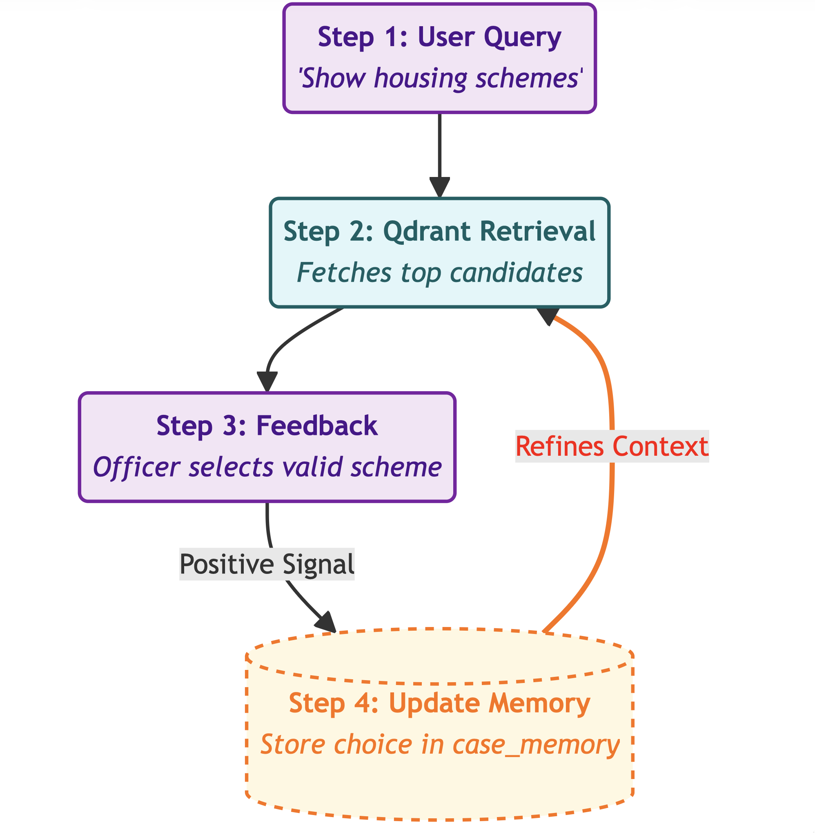
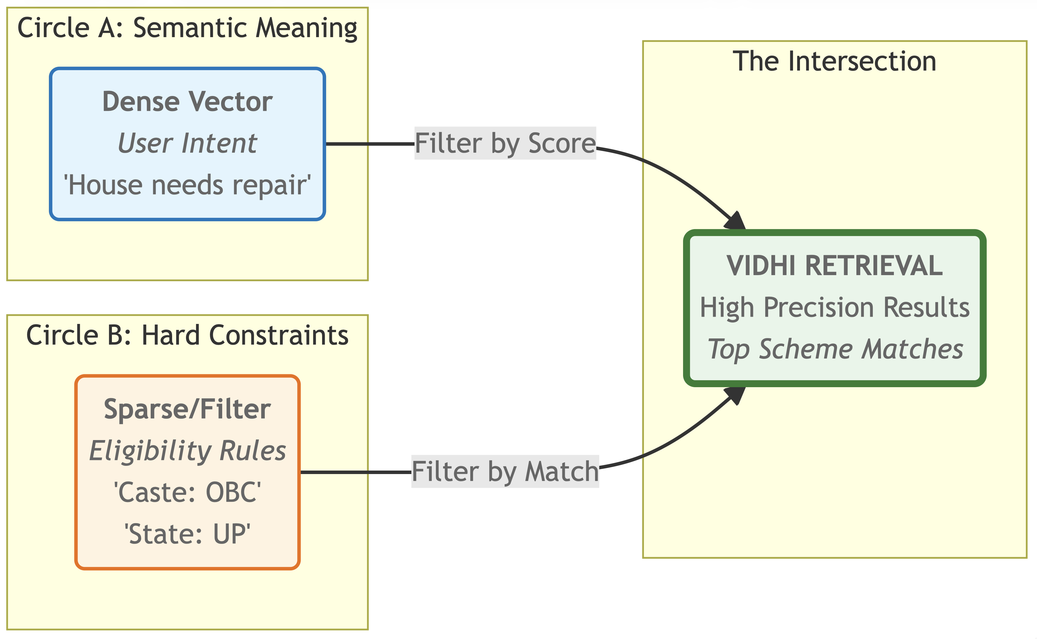
Multimodal Embedding Strategy

Slide 6
The Brain: Search, Memory & Reasoning
Hybrid Search Logic (The "Vidhi" Engine)
Dual-Stage Retrieval: Combines Dense (Semantic) and Sparse (Keyword) search for maximum recall.
Strict Filtering: Applies hard constraints first (e.g., filter: { state: "Telangana", caste: "OBC" }) to ensure zero hallucinations on eligibility.
Long-Term Memory (The "Context" Keeper)
Case Memory: Stores unique session IDs with status, feedback_score, and chosen_scheme_id.
Recency-Awareness: Recalls previous interactions to prevent repetitive questioning and adapt to changing user needs.
Explainable Output (The "Evidence" Pack)
Traceability: Every recommendation includes the specific Qdrant point ID, linking back to the official government source text.
Evidence-First: Outputs are not generic text; they are cited facts derived directly from the retrieved scheme documents.

Slide 7
Demo Walkthrough
Please look at the Google Drive

Slide 8

Impact, Responsibility & Ethics
1. Data Privacy & "Right to be Forgotten"
The Challenge: Storing photos of citizens' homes and personal data raises privacy risks.
Our Solution: We use on-device processing where possible. Vector embeddings are stored anonymously; PII (Personally Identifiable Information) is never stored in the vector payload, only eligibility signals (e.g., house_type: kutcha, not name). (Only the openAI key is the issue)
2. Handling Algorithmic Bias
The Challenge: Vision models might misclassify rural assets (e.g., confusing a shed for a pucca house), leading to unfair exclusion.
Our Solution:
Human-in-the-Loop: The AI is a Sahayak (Assistant), not a judge. The field officer always has the final override button on any detected signal.
Confidence Thresholds: If the vision model confidence is <70%, the system forces a manual verification step.
3. Explainability (Traceability)
The Challenge: "Black box" AI recommendations can hallucinate non-existent benefits.
Our Solution: We enforce Evidence-Based Retrieval. Every recommendation cited by the system includes a direct payload link to the source government PDF. If Qdrant cannot find a document match, the system returns "No Scheme Found" rather than inventing one.
4. Known Limitations
Language: Currently optimized for English/Hindi; requires fine-tuning for regional dialects.
Connectivity: While embeddings run locally, the final Qdrant verification currently requires intermittent internet access (Batch Mode).

Slide 9

What’s Next
Roadmap
Improve UI
Map fields to official scheme templates.
Strengthen secure key handling for mobile production.
Expand scheme dataset + multi-language outputs.

Slide 10
Thank you
Convolve 4.0

